Slide 1

PROCESS MINING VIRTUAL INTERNSHIP
by
S ABHINAY
224G1A3202
Department of Computer Science and Engineering (Data Science)
Srinivasa Ramanujan Institute of Technology
Autonomous
Rotarypuram Village, B K Samudram Mandal, Ananthapuramu – 515701.

Slide 2

Contents
Process Mining Virtual Internship
Course Objective
Introduction
Modules Explanation
Learning Outcomes
Conclusion
References
Internship Certificate

Slide 3
Course Objective
Process Mining Virtual Internship
The main objective of this course is to provide an understanding of Process Mining and its applications, helping students to monitor, discover, and improve business processes by analyzing event logs and utilizing data-driven insights. The course enables participants to develop skills in process analysis and optimization, thereby bridging the gap between industry and academia.
Key Goals:
Enhance employability by providing hands-on experience in process mining.
Develop an industry-ready workforce proficient in emerging technologies like Process Mining.
Equip students with tools and techniques to discover, validate, and improve workflows through data science.

Slide 4
Introduction
Process Mining Virtual Internship
What is Process Mining?
Before we start: What is a process?
Let’s get back to basics by defining processes first.
A process is a series of actions or steps repeated in a progression from a defined or recognized 'start' to a defined or recognized 'finish’.
The purpose of a process is to establish and maintain a commonly understood flow that allows a task to be completed efficiently and consistently.
Every step of a business process leaves a digital footprint in your transactional systems in the form of event log data.
Process mining software works by using this event log data to create a living picture of what your actual processes really look like which does not always match the definition you might have worked out in process mapping workshops.

Slide 5
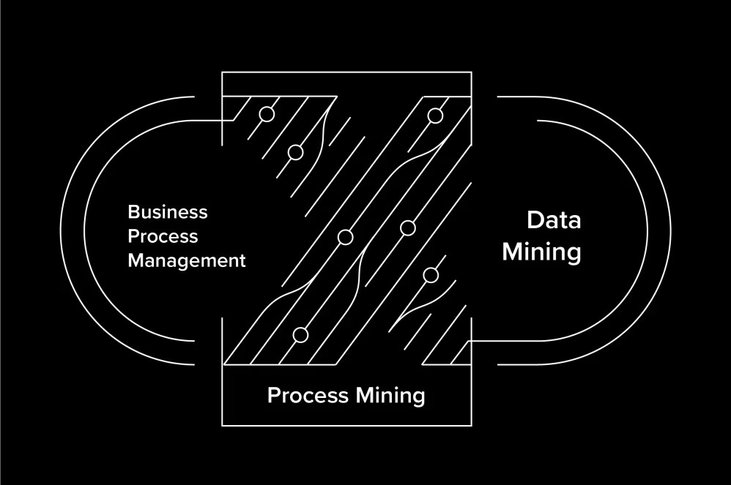
Contd..
Process Mining Virtual Internship
Process Mining:
Every process step you take leaves digital traces event log data in the transactional systems you use. Process mining extracts those digital traces and meaningfully connects them to help you understand your business better.
Celonis uses the event log data from process mining to create a digital twin of your business processes, helping you visualize every move your business makes in real time. The digital twin shows you your processes as they really are, allowing you to uncover opportunities for value, and to identify and fix inefficiencies. The beauty is that it can apply to any process for each system.

Slide 6
Modules
Process Mining Virtual Internship
Module-1: Foundations of Process Mining
Module-2:Building Analyses
Module-3: PQL Queries and Data Integration
Foundations of Process Mining
Building Analyses
PQL Queries and Data Integration

Slide 7
Module-1
Process Mining Virtual Internship
Foundations of Process Mining
Review and interpret Analysis
The Celonis Execution Management System (EMS) extends process mining by executing on insights automatically and orchestrating your existing technologies.
Process, Activity, Case:
Process: A series of linked steps taken in order to achieve a particular goal
Case: An item or object you follow through the process
Activity: Events that take place during a process
Use the variant explorer
As the name implies, using the Variant Explorer, you can discover all the process variants that is all the different ways the process flows in your organization.
The Variant Explorer is one of the Analysis tools to help you take an "exploratory" approach to find out how your process is performing.

Slide 8
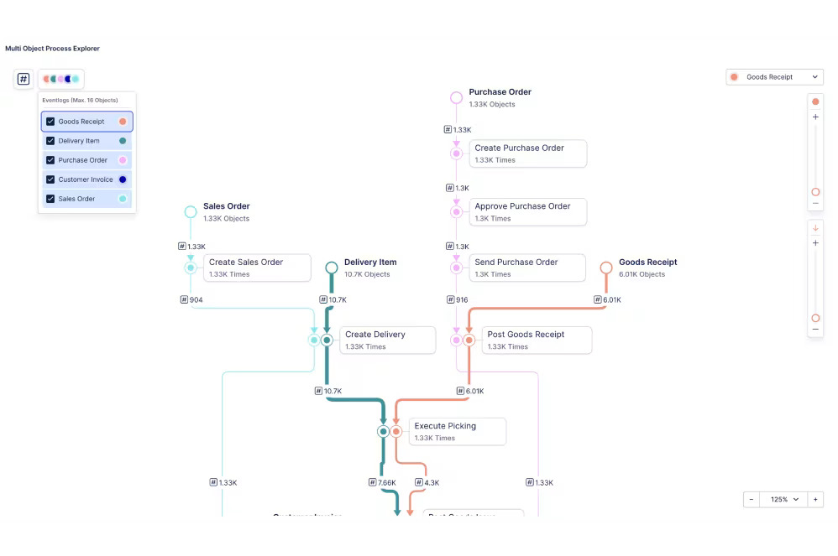
Contd…
Process Mining Virtual Internship
Use the process Explorer
The Process Explorer is another analysis tool to use when taking an exploratory approach. It's especially useful for quickly revealing activities beyond the most common ones.
It also allows you to narrow your focus on a single activity especially useful for quickly revealing activities beyond the most common ones.

Slide 9
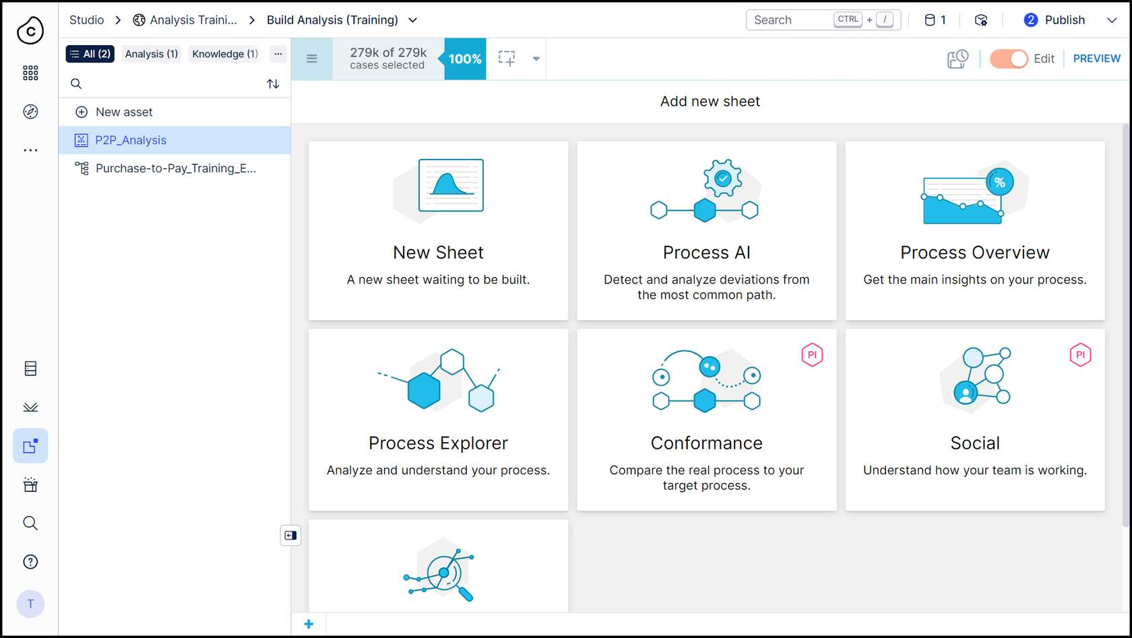
Module-2
Process Mining Virtual Internship
Building Analyses
As Celonis Analysis builder, the analyses you create are the interface between the data and the end-users. You help make digital business processes transparent so that users in operational and leadership roles can make data-driven decisions.
Everyone become familiar with best practices in gathering user requirements as well as in data visualization—to make data understandable, easy to work with, and visually appealing.

Slide 10
Contd…
Process Mining Virtual Internship
Configure tables and charts in analysis
To add dimensions and KPIs to an analysis component, you'll need to work with the data tables in the analysis. In the SAP Purchase-to-Pay (P2P) data model we work with for this training, we have four tables regardless of whether we're selecting dimensions or KPIs.
The principle of creating table and chart components in Celonis is always the same. Although, you'll need to select only one KPI to display in a Pie Chart. Celonis Analysis includes four types of single KPI components. The most common use cases for the single KPI component include the case count and net value. For both, you would use the Number KPI.
Single KPI Components: Celonis Analysis includes four types of single KPI components, commonly used for tracking case counts and net values with the Number KPI.
Activity Table: Contains three columns:
Case: Identifies the tracked object (e.g., purchase order items).
Activity: Lists activities performed on those items.
Event Time: Records when each activity occurred.
Creation of Activity Table: Data Engineers compile the Activity Table from digital footprints in the source system, which detail what happened, when, and the associated identifier (e.g., sales order number).

Slide 11
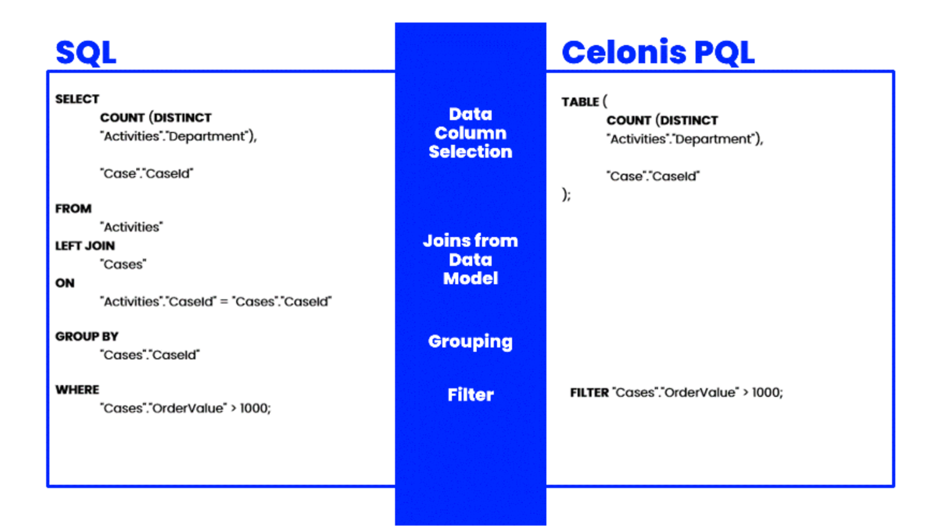
Module-3
Process Mining Virtual Internship
PQL Queries and Data Integration
Event Logs: In process mining, event logs are crucial as they capture how business processes operate. These logs include three key attributes:
Case: Indicates the specific process instance.
Activity: Describes the action taken during the event.
Timestamp: Records when each event occurred, allowing for chronological tracking.
Celonis PQL Engine: PQL (Process Query Language) is integral to Celonis software architecture, enabling data queries from a data model. It differs from SQL in that PQLs are behavior-based, focusing on leads likely to convert, while SQLs are intent-based, aimed at closing deals.

Slide 12
Contd…
Process Mining Virtual Internship
Data Integration: This involves creating a data pipeline to bring clean, real-time process data into the EMS (Execution Management System). Key steps include:
Setting Up a Data Pipeline: Involves data integration basics, connecting to systems, extracting, transforming, and loading data into a model.
Refining the Data Pipeline: Includes scheduling jobs, monitoring data quality, and ensuring seamless integration across multiple processes.
Activity Table: This table compiles all activities related to ordered items, forming the core of process data. It consolidates data from various systems and serves as the foundation for analysis and process improvement.
Final Data Model: The end result of data integration is a comprehensive data model that links activity tables, case tables, and master data tables together for effective analysis.

Slide 13
Learning Outcomes
Process Mining Virtual Internship
Understand what process mining is and the basics of how it works.
Understanding how process mining helps in Business world.
Summarize what an event log is and why we need it for processing.
Identify business use cases for process mining.
Learn how to find training courses to get started.
Understanding how to discover, analyses, and improve business process using data driven techniques.
You will learn to extract insights from event logs, identify bottlenecks, inefficiencies, and opportunities for optimization.

Slide 14
Conclusion
Process Mining Virtual Internship
In conclusion, process mining provides powerful insights that significantly enhance business process improvement by combining data mining and process analytics to visualize actual workflows. Organizations leveraging this technology can increase efficiency, reduce costs, improve compliance, and make informed, data-driven decisions for process optimization. As this field continues to grow and gain traction across various industries, successful implementation hinges on a thorough understanding of both the underlying technology and the specific business processes involved. Ultimately, organizations that embrace process mining position themselves to gain a competitive advantage through ongoing refinement and optimization of their operations.

Slide 15
References
Process Mining Virtual Internship
Login page: https://academy-login.celonis.com/s/login/
https://academy.celonis.com/learn/course/introduction-to-process-mining/introduction-to- process-mining/course-outline?client=academic-alliance-celonis&page=2
https://www.ibm.com/topics/píocess-mining

Slide 16
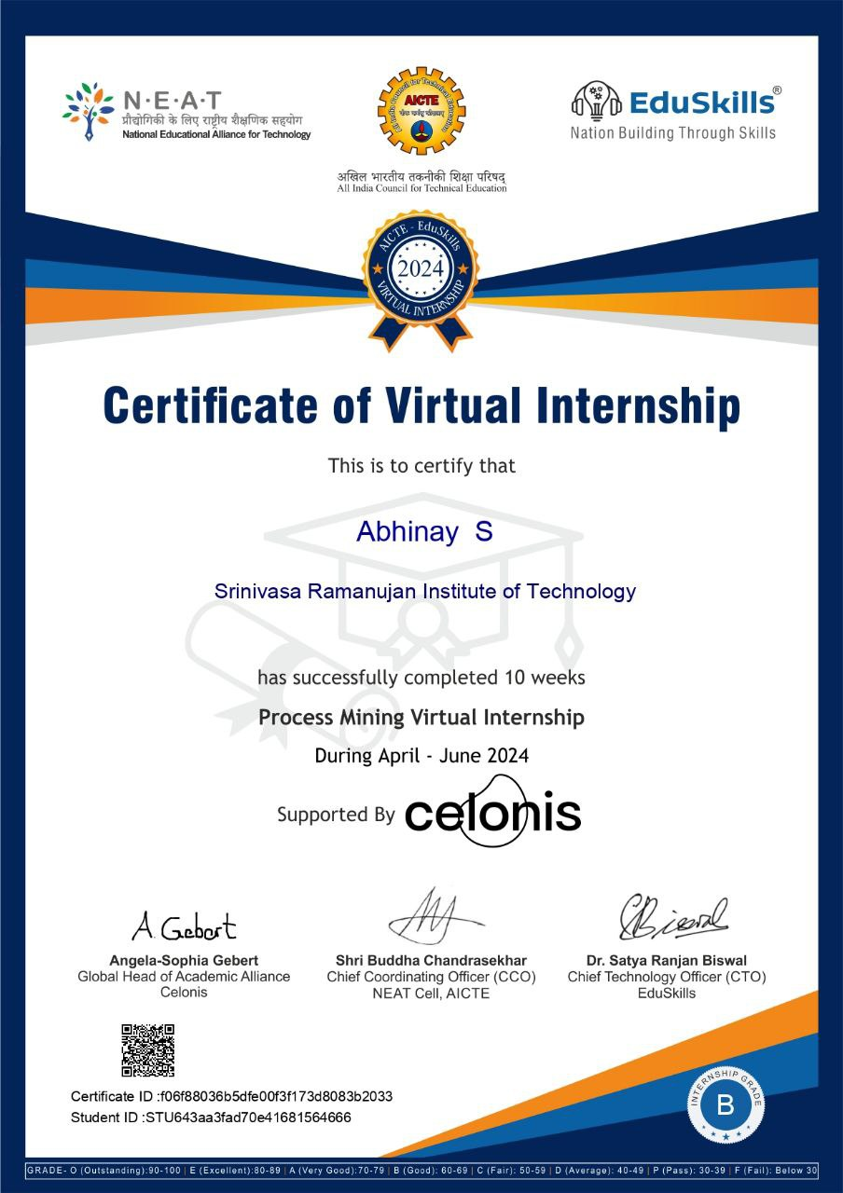
Internship Certificate
Process Mining Virtual Internship

Slide 17
Github Link:
Process Mining Virtual Internship

Slide 18
Process Mining Virtual Internship
Thank You!!!

